Slide 1



Do you care for a spouse, relative or friend?

Slide 2

Our expert team is here to help you

Slide 3

Get the information, support and advice you need

Slide 4
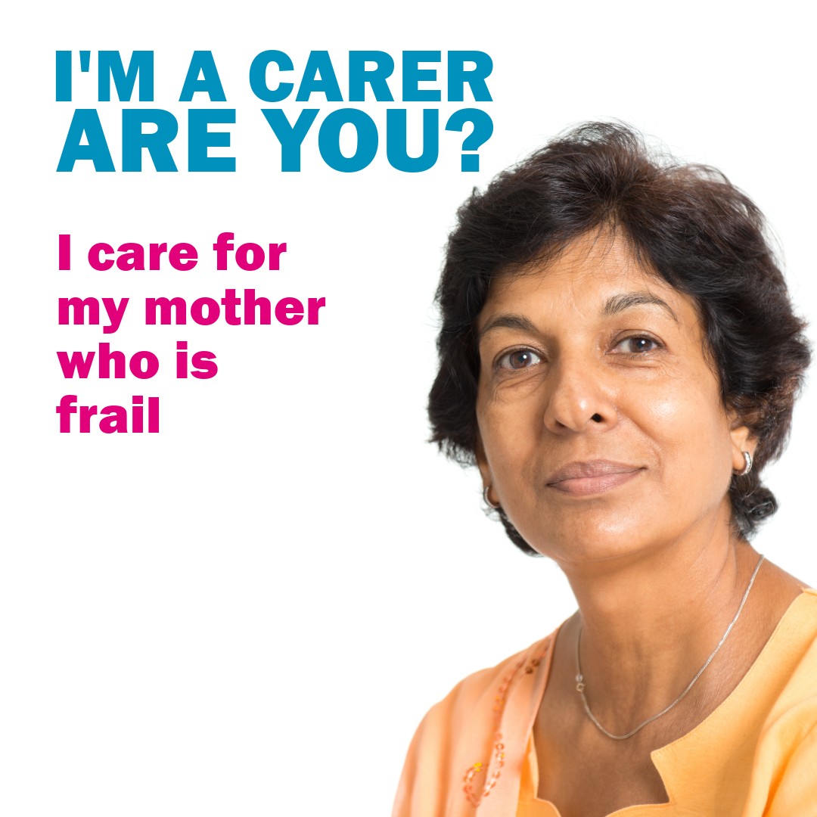
In Barnet,
We THINK carer

Slide 5

Contact us today
0203 995 1909
adultcarers@barnetcarers.org
barnetcarers.org

